Slide 1
Collaborative Filtering

Slide 2
Group members
Wei, Yina
Duan Shiqi
Lu, Qingyun
Ni, Jiayu
Yasuda, Saaya

Slide 3
Memory Based Algorithm
Similarity weight:
Spearman Correlation
Vector Similarity
Mean-square-difference
Variance Weighting
Selecting Neighbors:
Rating Normalization: prediction

Slide 4


Similarity weight
Weight all users with respect to similarity with the active user:
Spearson Rank correlation
Vector Similarity
Mean Squared difference Algorithm
(Ux-Uy)^2

Slide 5


Variance Weighting
We hypothesized that giving the distinguishing movies more influence in determining a correlation would improve the accuracy of the prediction algorithm.
We modified the previous algorithm to incorporate an item-variance weight factor.
Previous algorithm
After variance weighting

Slide 6
Selecting Neighborhoods
Absolute Correlation Threshold
All neighbors with absolute correlations greater than a given threshold are selected
Best n correlates for a given n
Choose the n highest similarity neighbors
Combining the two algorithms

Slide 7

Prediction
Rating normalization using z scores:

Slide 8
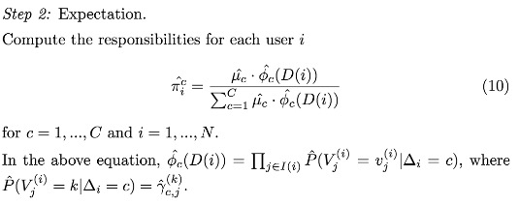
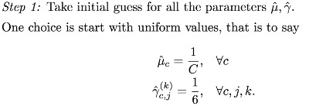
Model based algorithm
Cluster Models

Slide 9
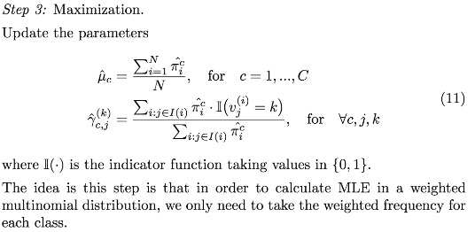


Slide 10
Performance Metrics (data set2)
model | Similarity weighting | Variance weighting | Selecting Neighbors | ROC | MAE
Clustering model | - | - | - | 0.7382 | 1.0137
Memory based model | Spearman | no | Best n | 0.7477 | 1.2660
 | Spearman | no | threshold | 0.7164 | 1.3528
 | Spearman | no | combined | 0.7156 | 1.3664
 | Spearman | yes | Best n | 0.7236 | 1.2623
 | Vector | no | Best n | 0.7236 | 1.2341

